Slide 1
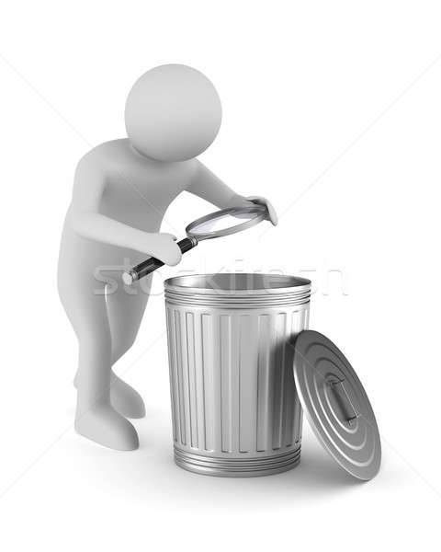
New trends in chemical engineering The Challenge by Waste
Fyodor Malchik

Slide 2
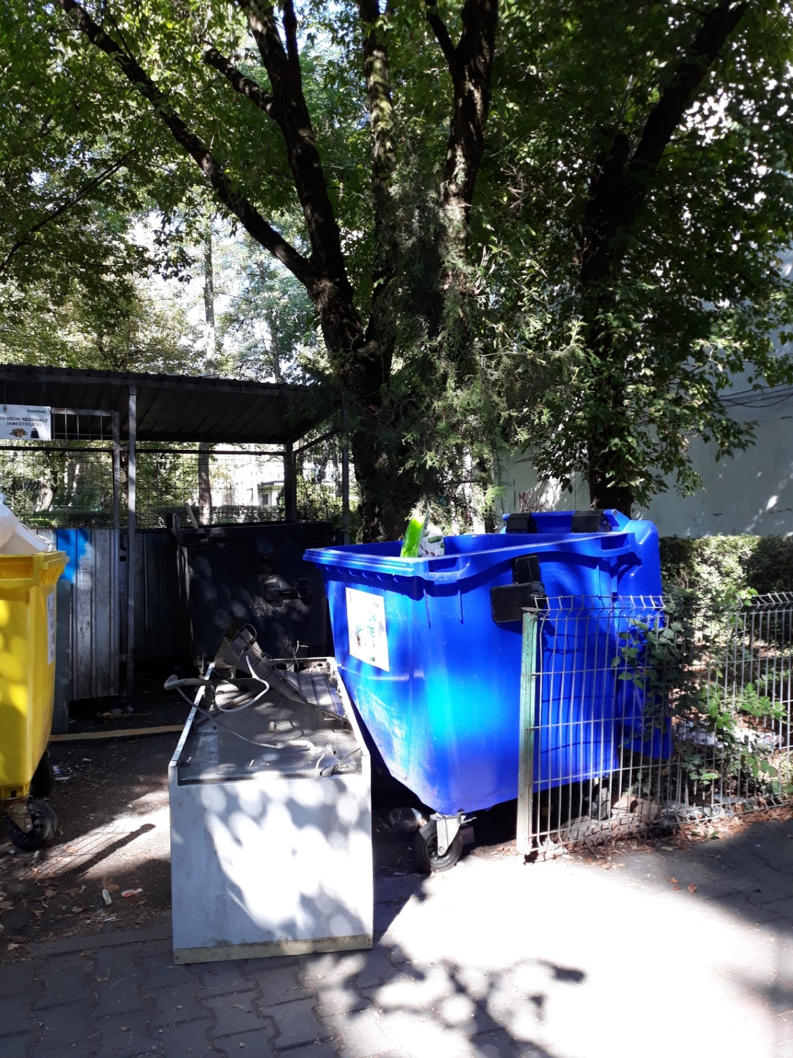
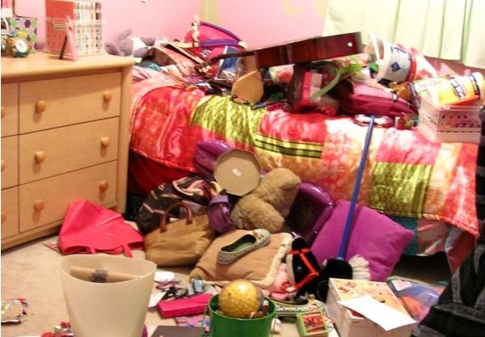
Cleaning or Renovating

Slide 3
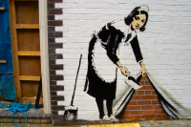
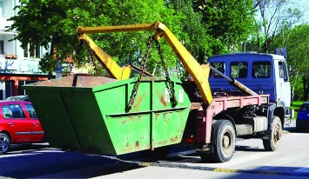
Usually available solutions
are NOT SOLUTIONS

Slide 4
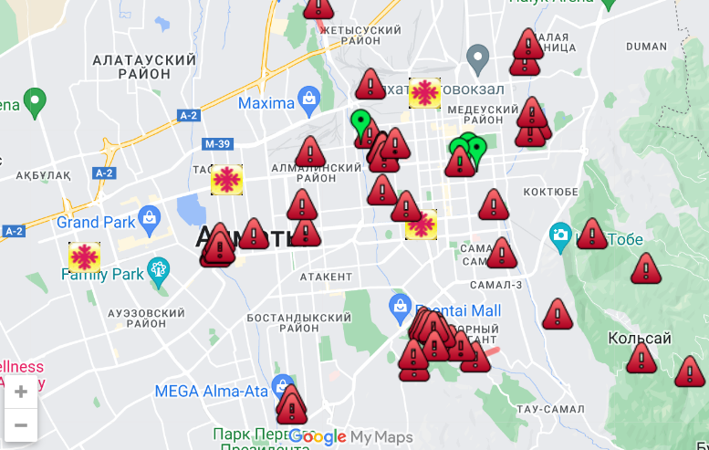

Slide 5
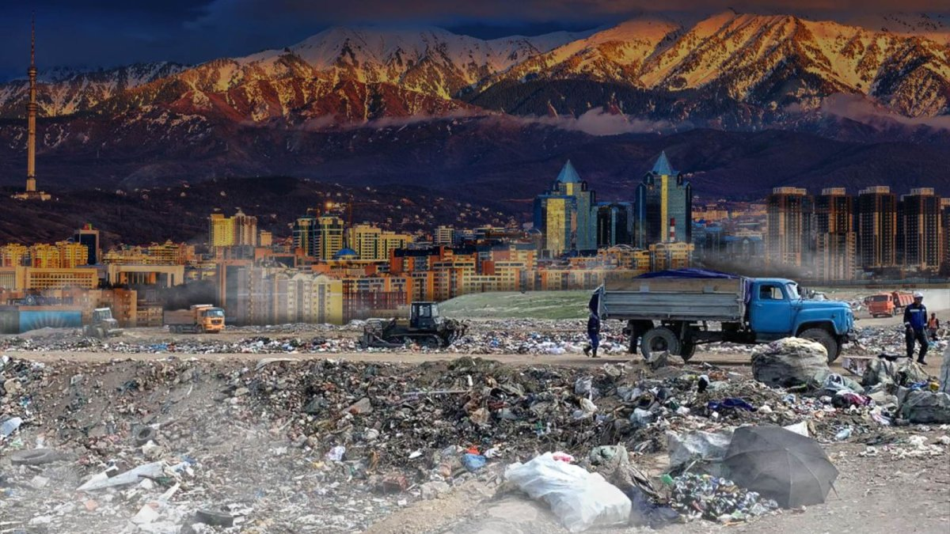
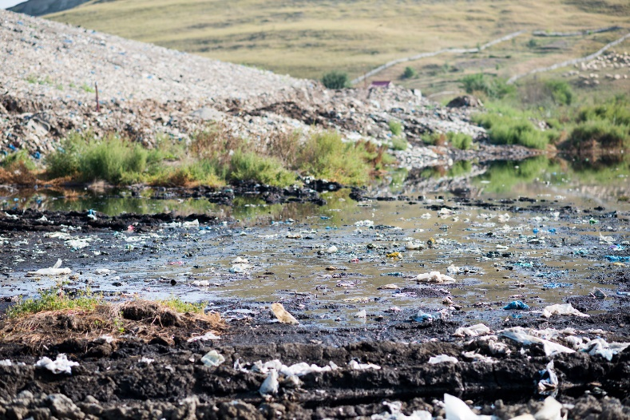
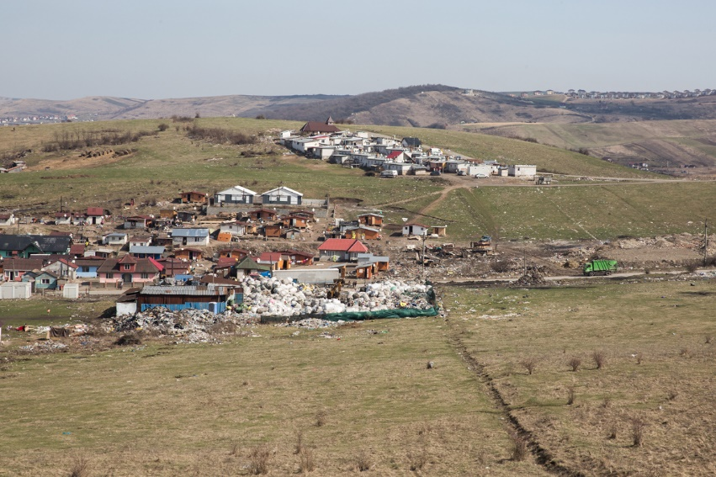
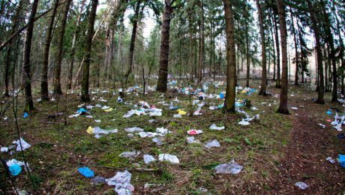
Site of waste deposit - Almaty
https://youtu.be/fBFXobYjhy0

Slide 6
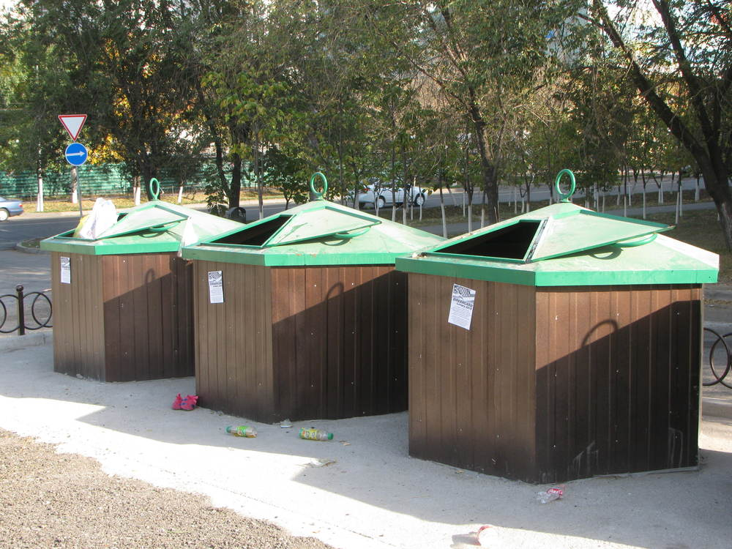
Site of waste deposit – Almaty

Slide 7
County data for 2013-2023
2013: 335.000 tones dry waste
481 kg/person/year: - 86% urban → 615 kg/person/year
- 14% rural → 209 kg/person/year
16% treated / processed
70 waste deposits → to close / modernize
CIS norms ➔ need of LOCAL STRATEGY

Slide 8
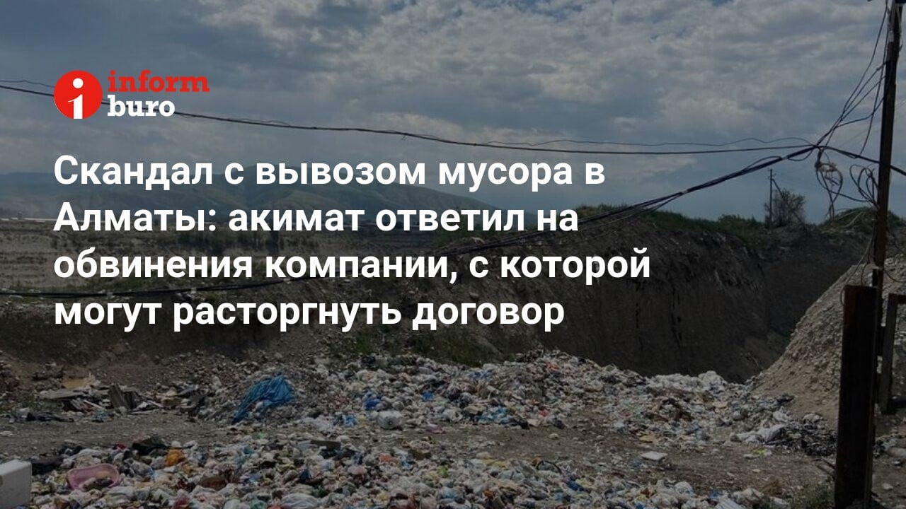
Decisions of town council
Town council: 16443/3.11.2009 → Regional plan
(10 chapters, 206 pages)
System for integrated waste management – Almaty
Centre for mechanic and biologic treatment
(near the city Almaty)

Slide 9
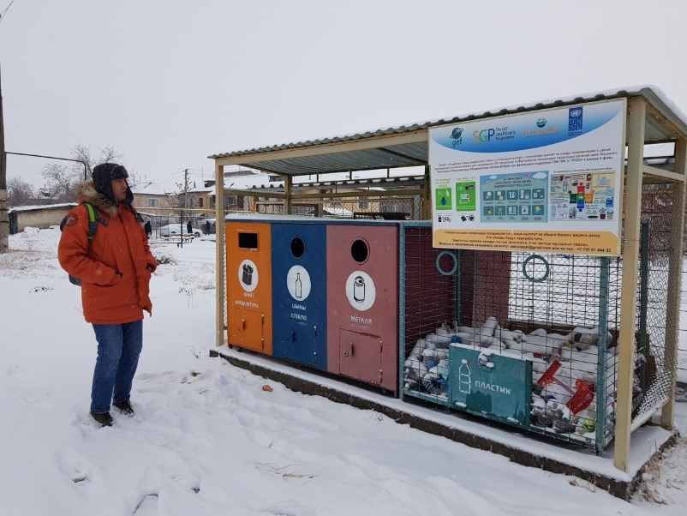
Collecting + transport
Treatment
Depositing
Technical support and education of population

Slide 10
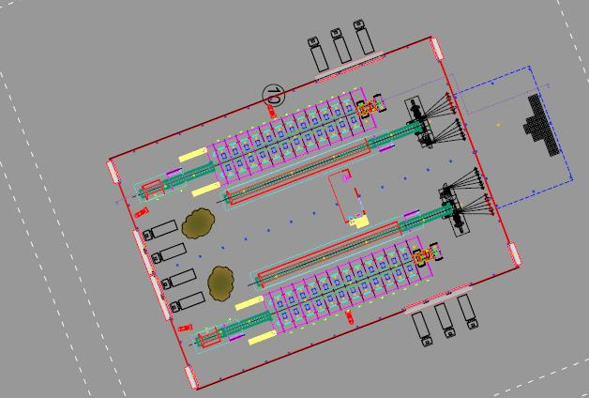
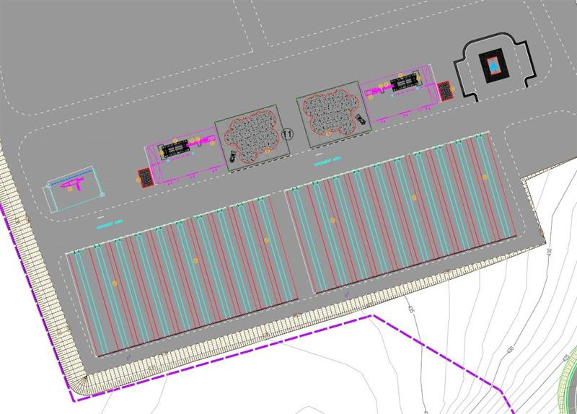
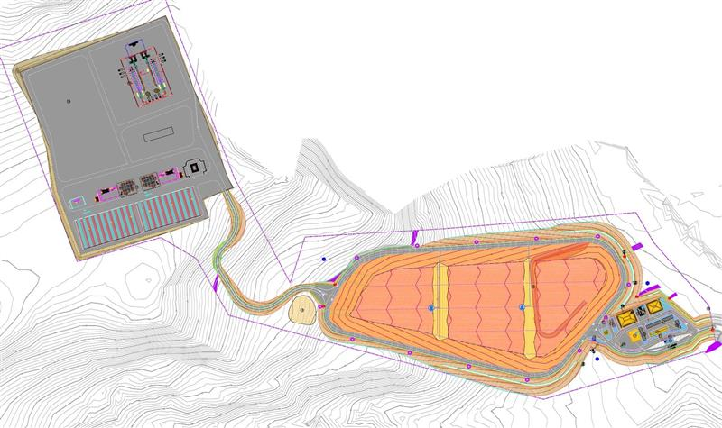
“System for integrated waste management -Almaty”
Treatment dry waste: 92.100 tones/year
Treatment humid waste: 206.000 tones/year
Deposit: 216.000 tones/year = 247.600 m³/year

Slide 11
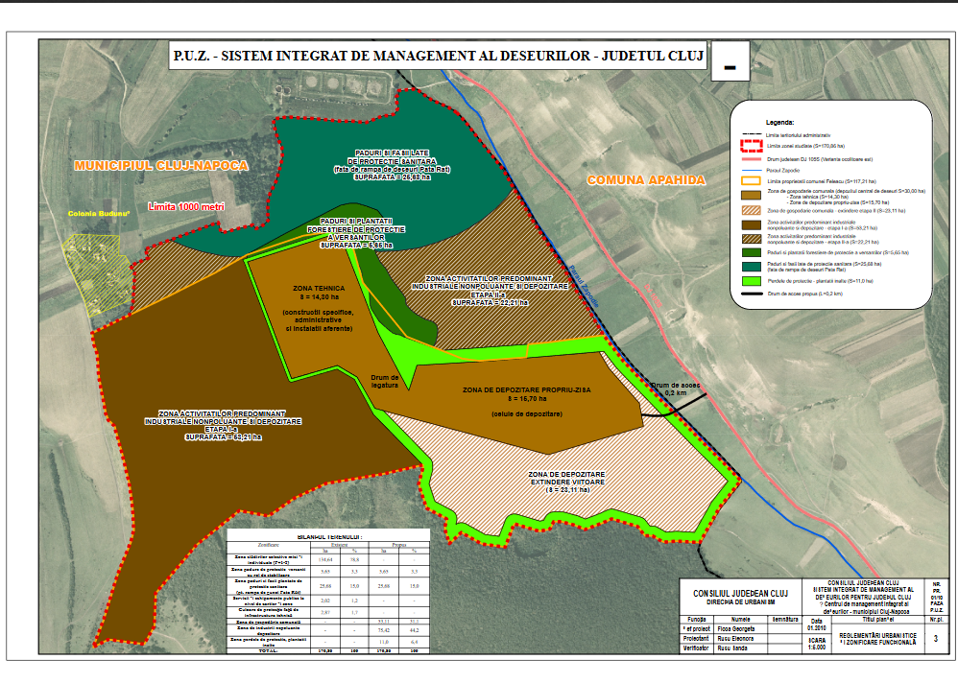
“System for integrated waste management - Almaty”
2 long-term deposits:
7.7 ha, 1.350.000 m³, 5 years
17.9 ha, 6.900.000 m³, 19 years

Slide 12
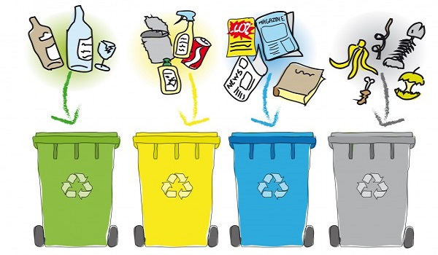
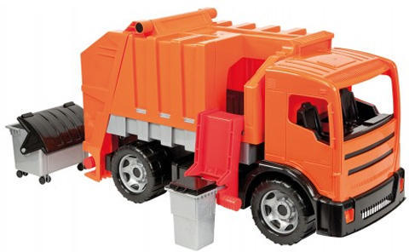
Since 2019, July the 1st
Compost
(vegetal, no wood)
ROSAL
BRANTNER

Slide 13
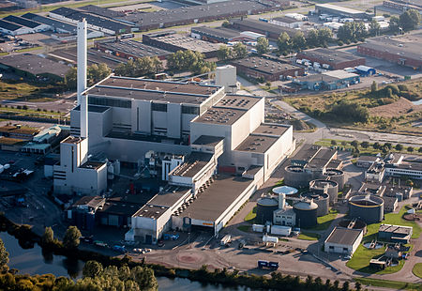
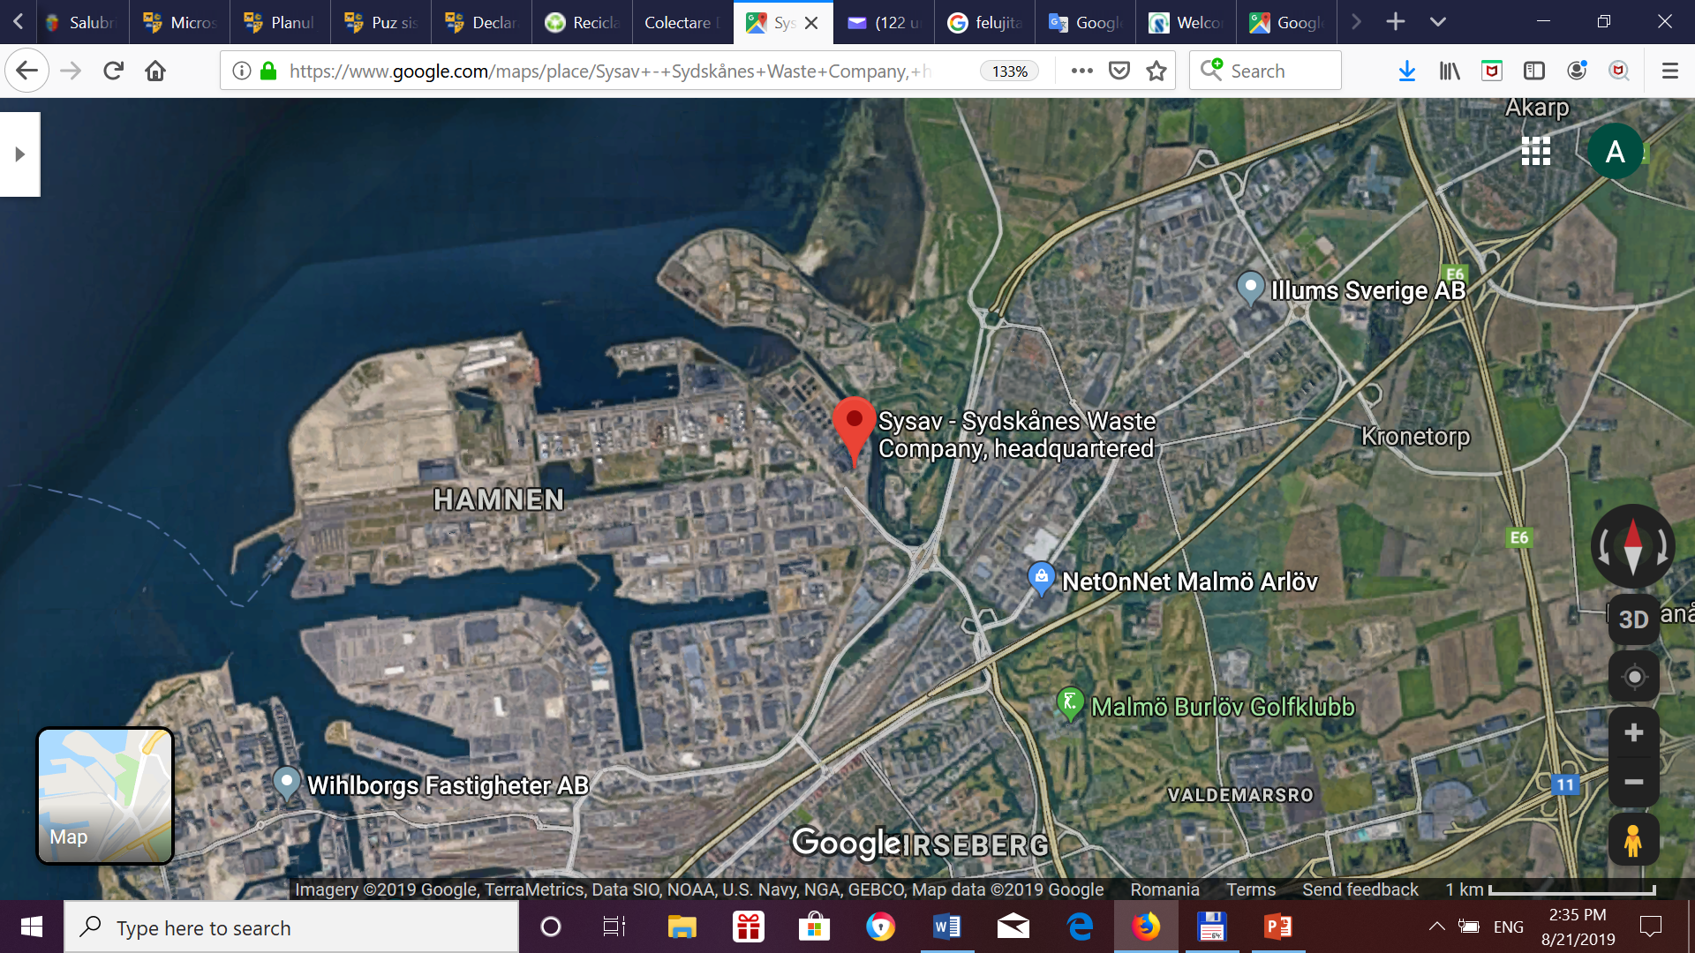
SYSAV, Malmö, Sweden (Sysav South Scania Waste) Waste-to-Energy Plant
Owned by 14 local authorities

Slide 14
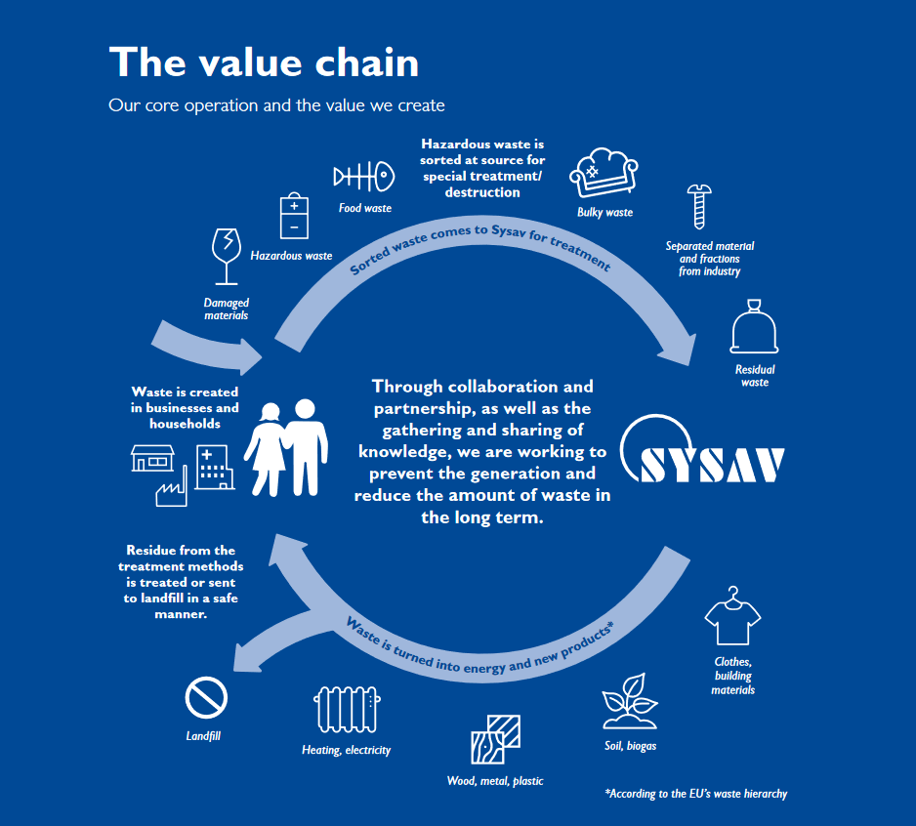
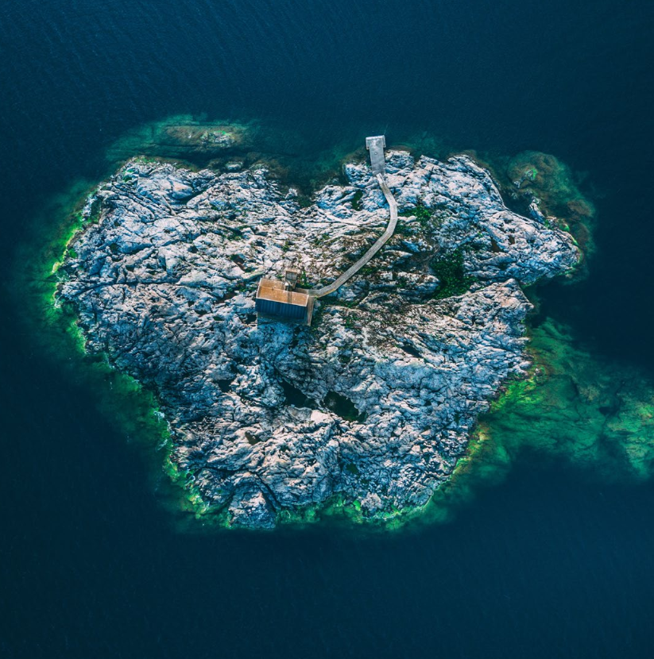
ADMINISTRATION REPORT
SYSAV 2018

Slide 15
ADMINISTRATION REPORT / SYSAV 2018

Slide 16
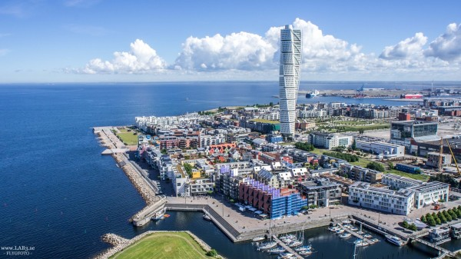
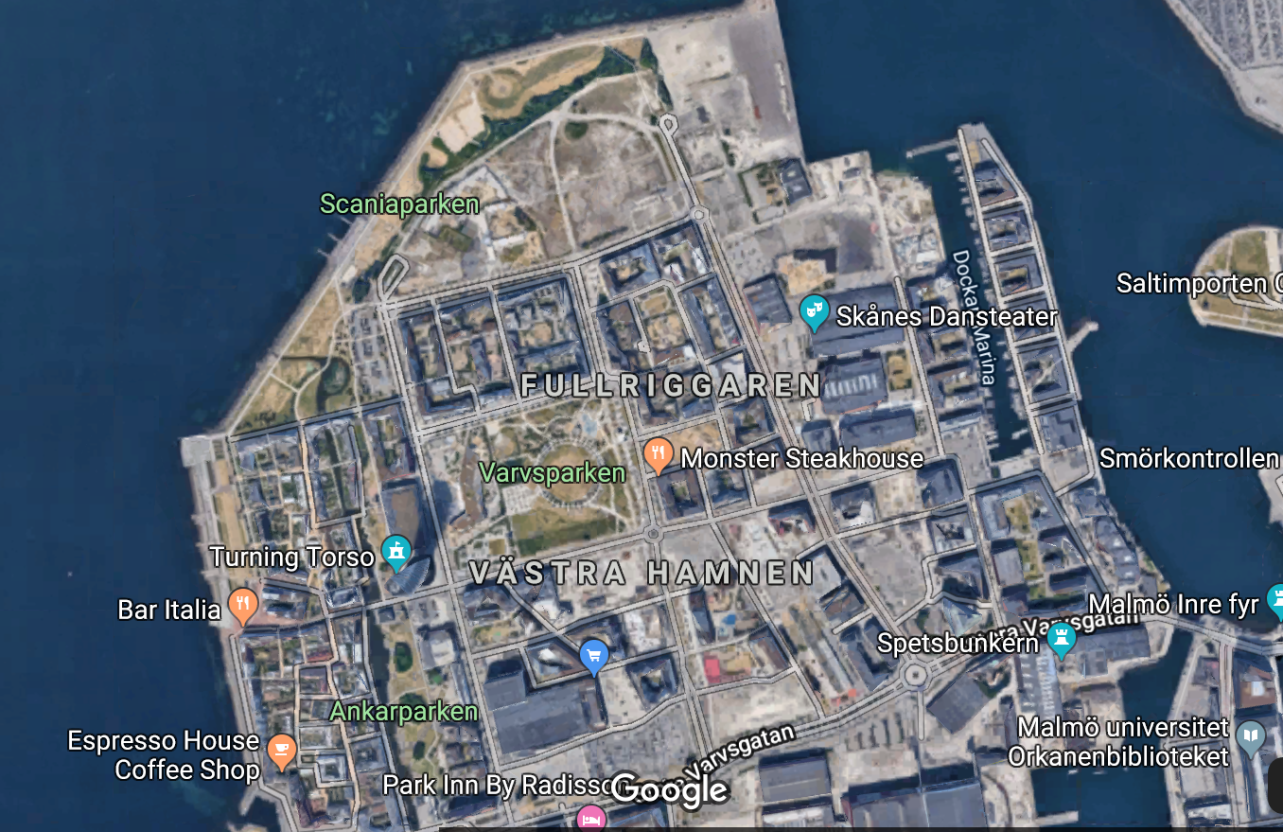
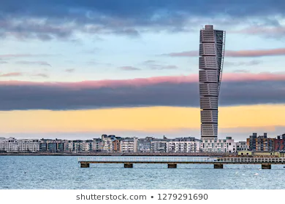
Malmö – Västra Hamnen
Smart City

Slide 17
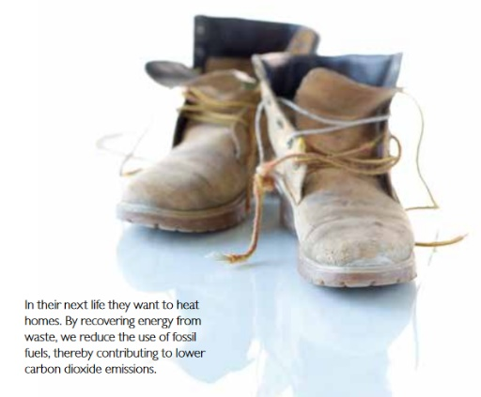
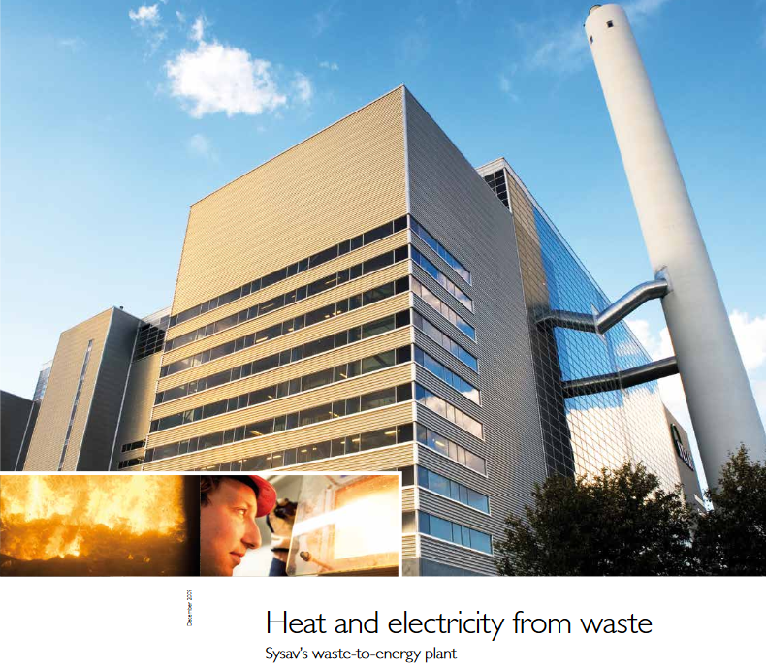
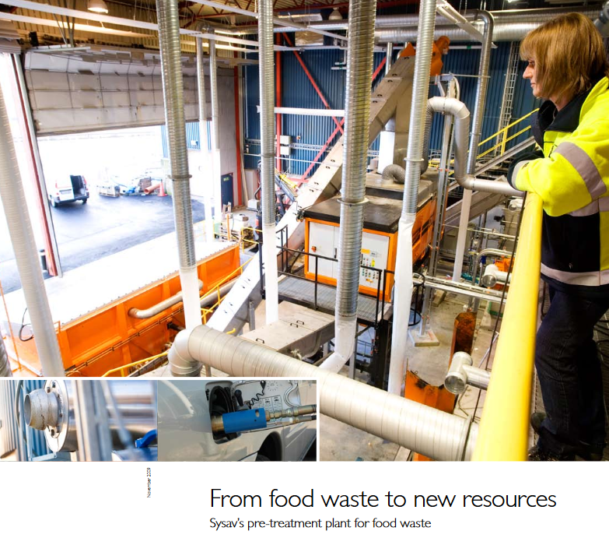
SYSAV concept

Slide 18
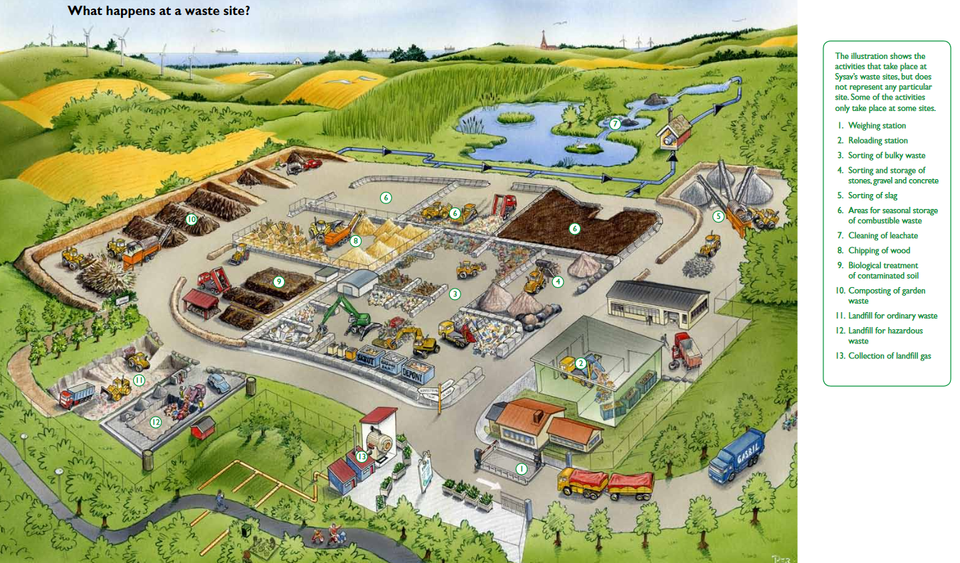
SYSAV

Slide 19
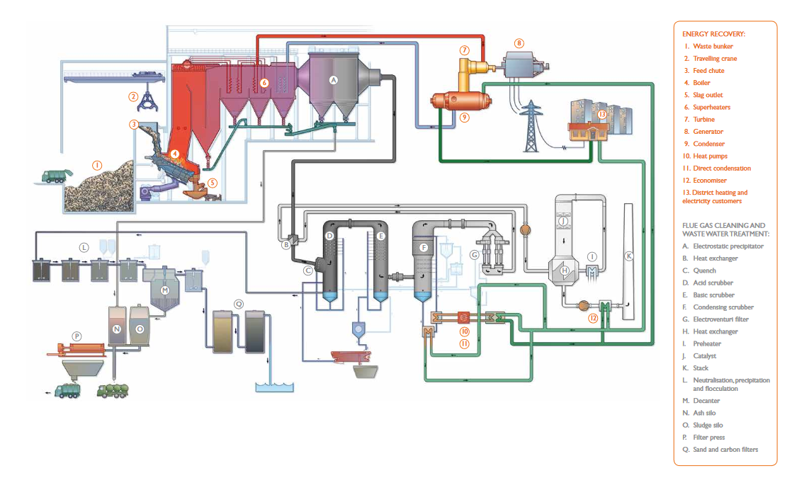
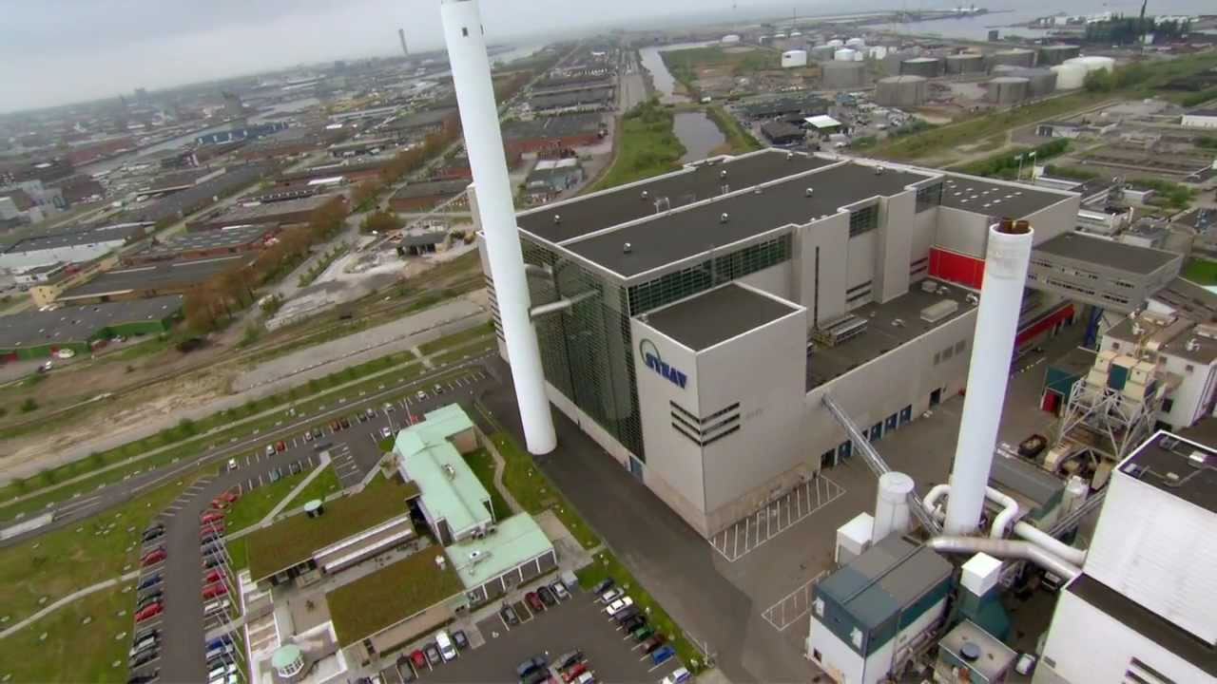
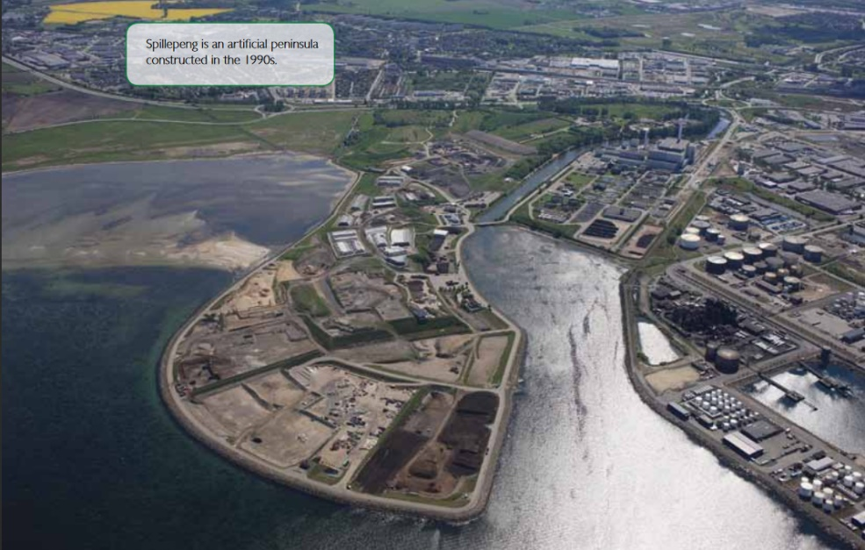
SYSAV

Slide 20
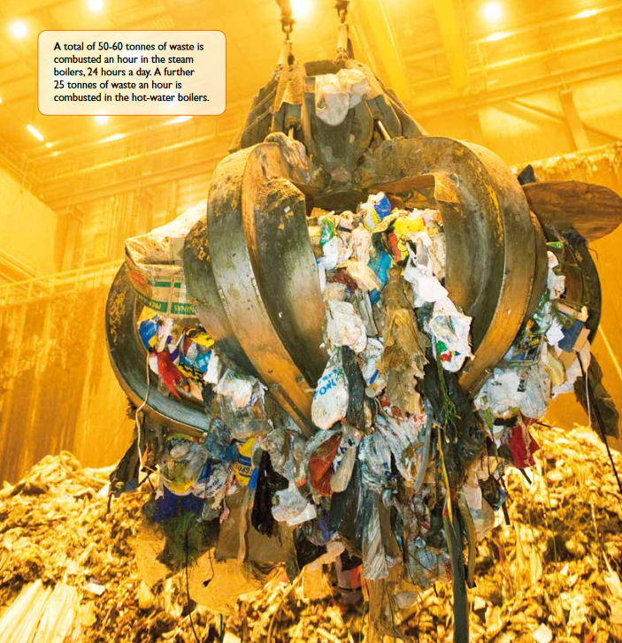
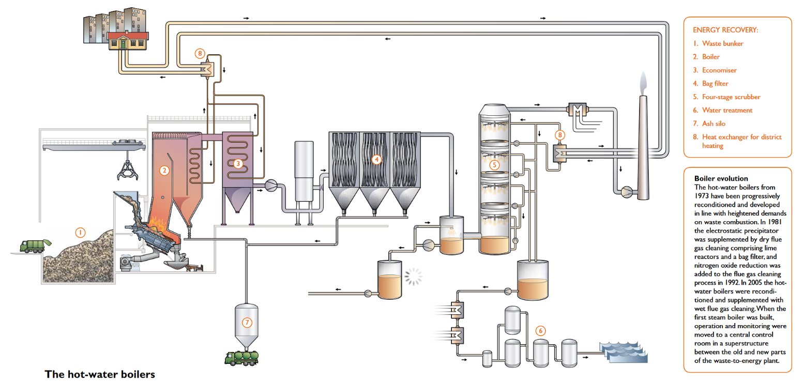
SYSAV – Remote heating

Slide 21
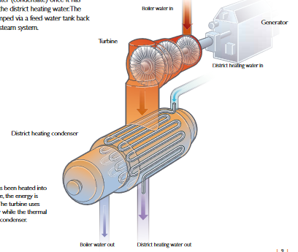
SYSAV – Electricity production

Slide 22
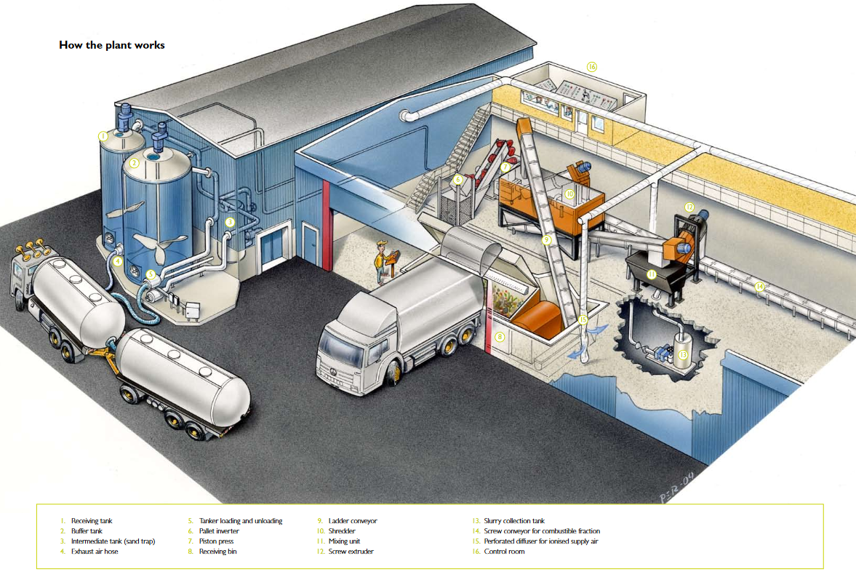
FOOD → Biogas
SYSAV

Slide 23
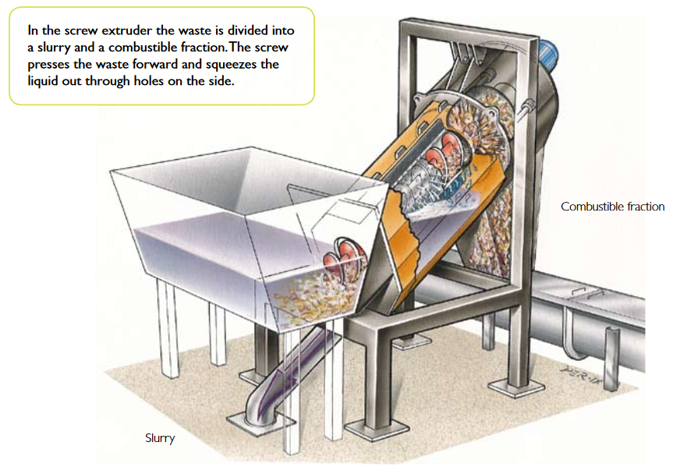
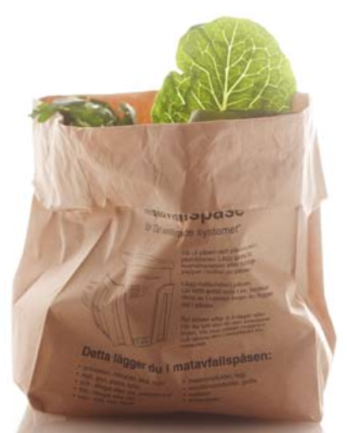
SYSAV: Food waste usage

Slide 24
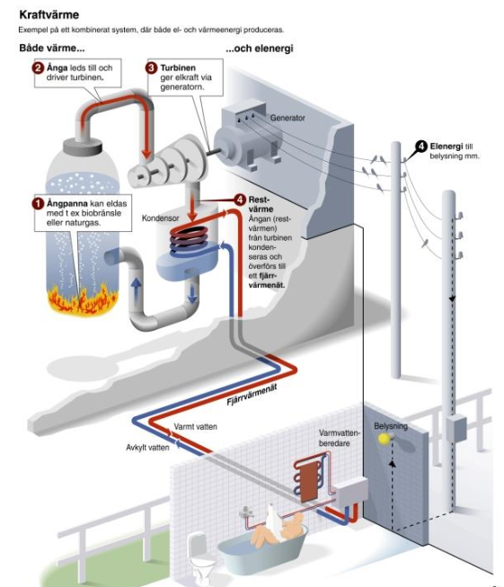
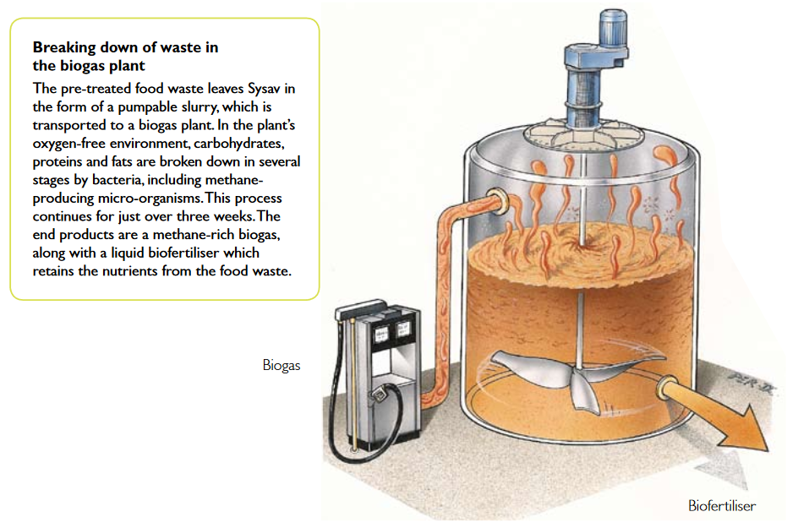
Biogas

Slide 25
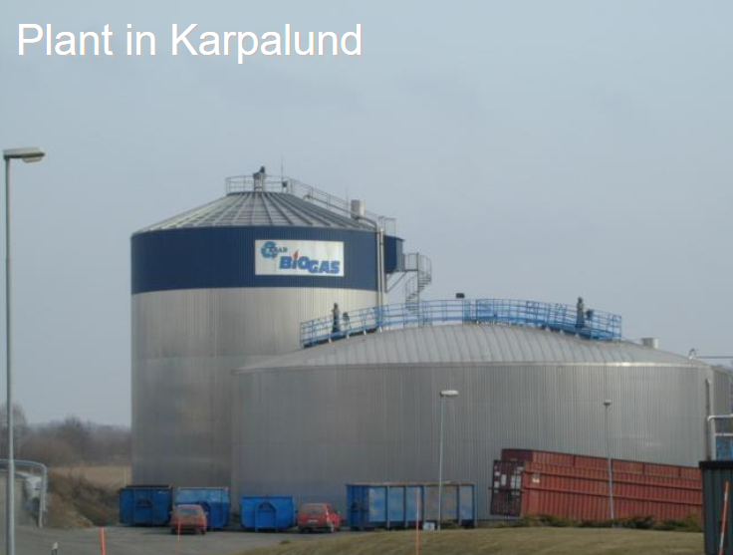
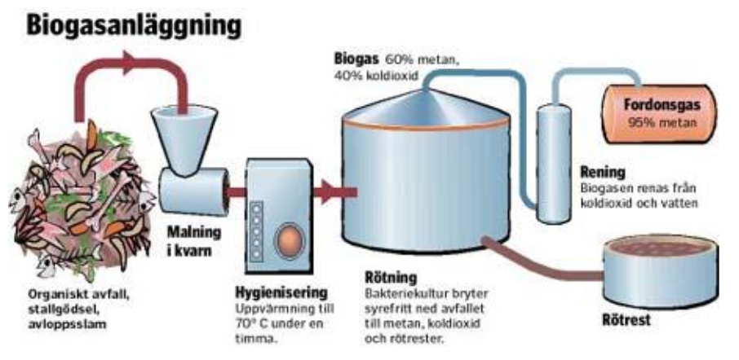
Karpalund Biogas Plant, Kristianstad Sweden

Slide 26
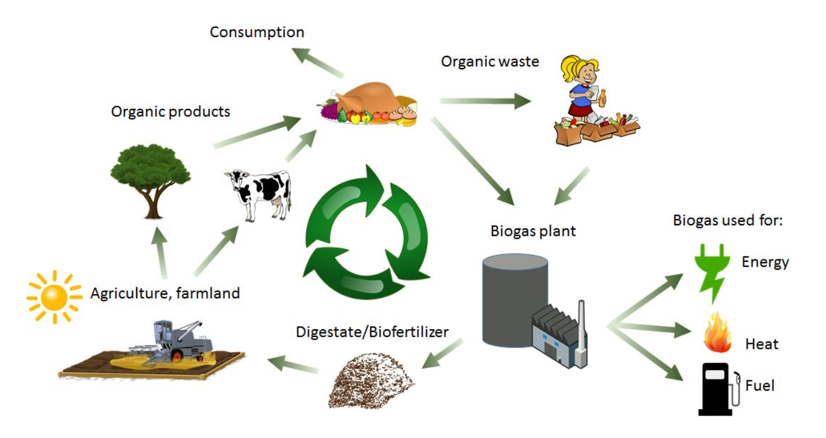
Sources for Biogas

Slide 27
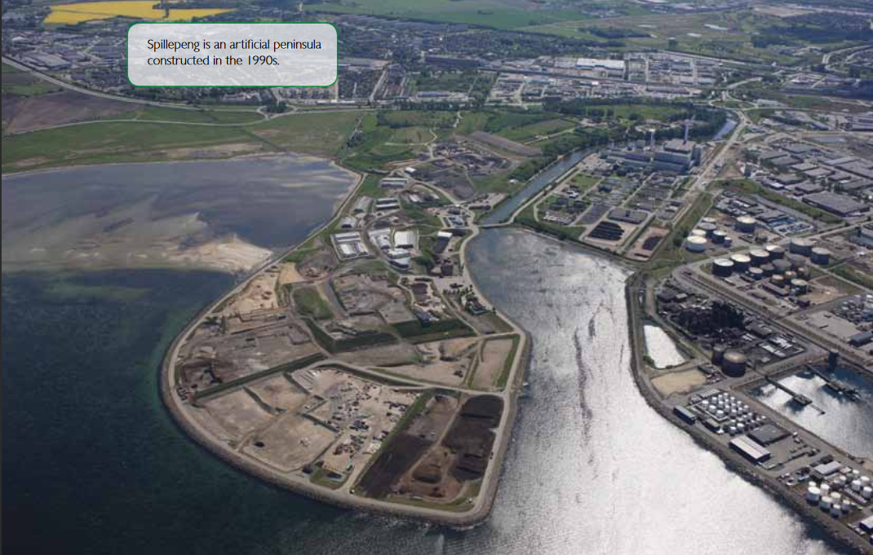
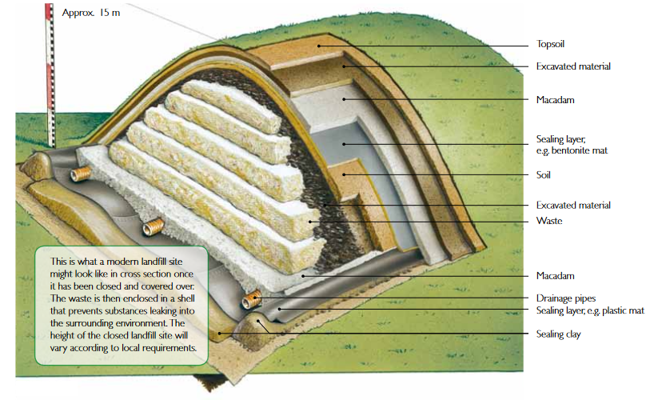
Final deposit (“Landfill”)

Slide 28
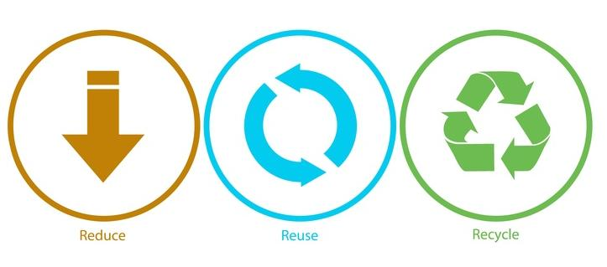
The three “R”

Slide 29
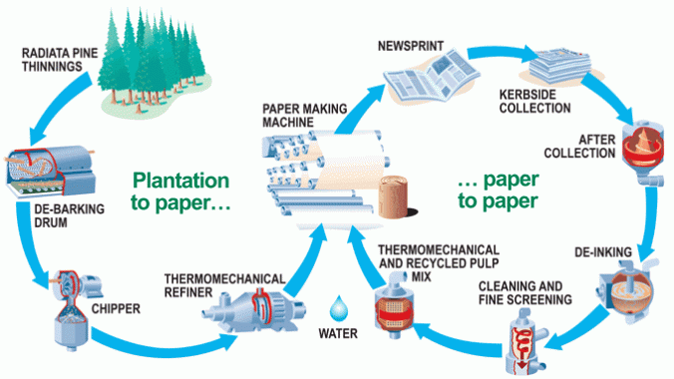
Paper waste

Slide 30
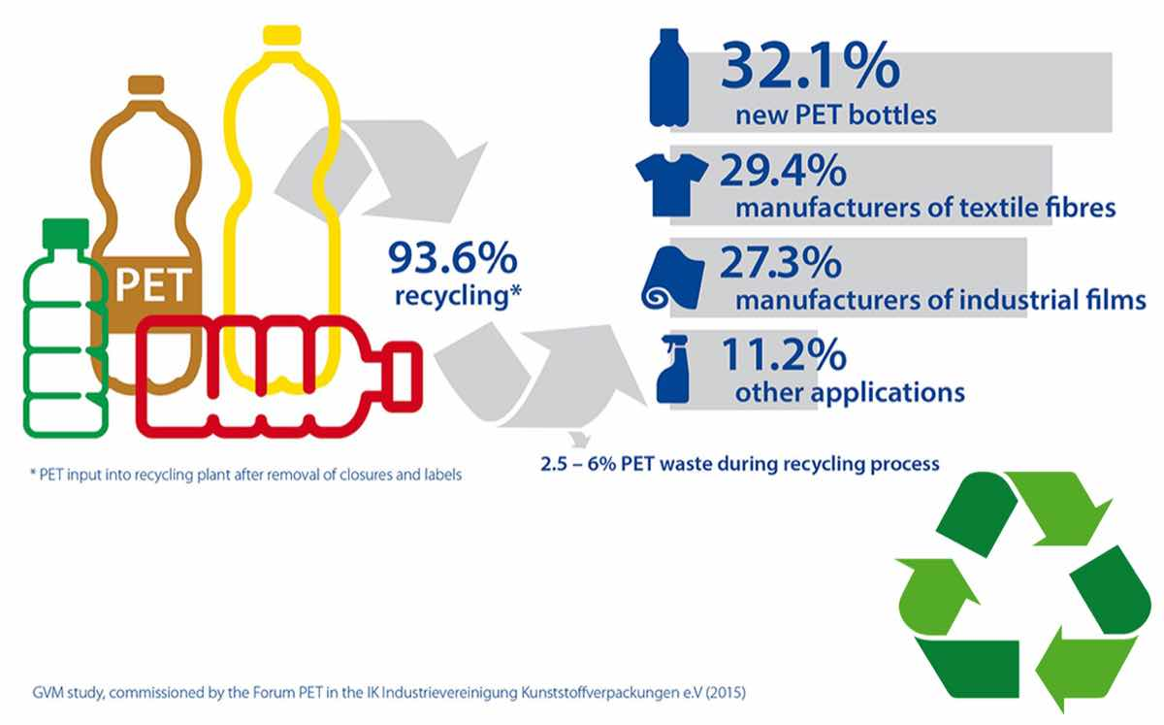
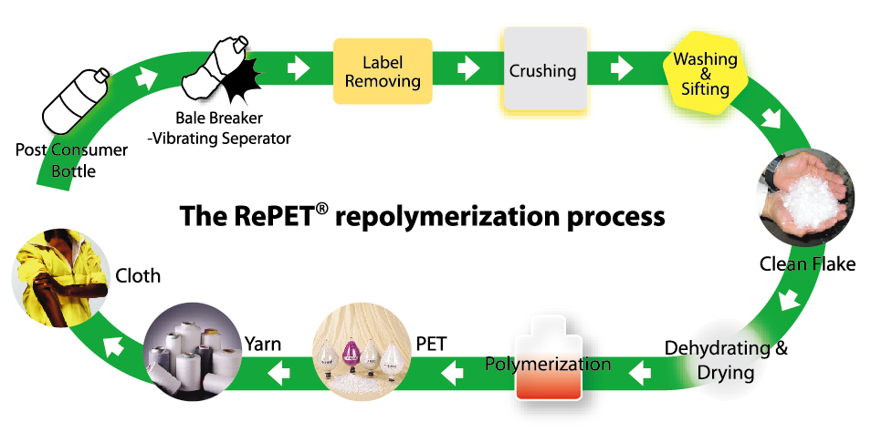
PET waste

Slide 31
Glass waste

Slide 32
Metal waste

Slide 33
Textile waste
1 T-shirt = 800 L water
1 t clothing = 10 t steel (energy consumption)
24% insecticides → cotton

Slide 34
“E-Waste”

Slide 35
“Special” categories

Slide 36
“Special” categories

Slide 37
Some concluding thoughts
Situation of Cluj-Napoca city – beginnings
Personal contribution
Contribution of society / authorities
+ RE-Design

Slide 38
Thank you!

